Slide 1
Progress Presentation
Health-Wise Lifespan Assessment using IoT and AI
by
Hardik Sen
Reg No. 210907288
Under the guidance of
Internal Guide External Guide
Prof. Prashant M Prabhu Dr. Spoorthi Singh
ECE, MIT Manipal Mechatronics, MIT Manipal

Slide 2
Recap of Previous Presentation
Data Collection & Preprocessing:
• Collected global health data from trusted sources like WHO
• Handled missing values, performed normalization, and feature engineering
Model Selection:
• Chose XGBoost for its accuracy, speed, and handling of tabular data
• Explained parameters, boosting trees, and regularization techniques
Training & Evaluation:
• Achieved high performance with metrics like R² score and MAE
• Performed cross-validation to avoid overfitting

Slide 3
Contents
Introduction
Methodology: – Data Collection & Preparation
– Embedding the Text Chunks
– Vector Storage
RAG System Architecture
References
Next Presentation Overview

Slide 4
Introduction
We are building a Domain-Specific Knowledge Base—a structured collection of high-quality information from trusted sources like books, research papers, and medical literature.
Why is it important?
Ensures accuracy and relevance in applications like medical chatbots.
Reduces hallucination by grounding responses in verified sources.
Enhances the performance of Retrieval-Augmented Generation (RAG) systems.

Slide 5
Methodology – Data Collection & Preparation
Data Collection
Collected domain-specific content from: • Academic books • Peer-reviewed research papers • Trusted online medical literature
Ensured credibility, accuracy, and domain alignment.
2. Loading PDF Files
Used PDFPlumber for clean text extraction.
Handled multi-column layouts, images, and references.
3. Text Splitting
Split extracted text into chunks of 500 tokens with 100-token overlap.
Overlapping helps preserve context across chunks.

Slide 6
Methodology – Embedding the Text Chunks
4. Perform Embedding
Applied HuggingFace Sentence Transformer: all-mpnet-base-v2.
Converted each text chunk into high-dimensional vector representations.
What is Embedding?
Embedding is the process of transforming text into numerical vectors.
These vectors capture semantic meaning, allowing comparison and retrieval based on similarity.
Why all-mpnet-base-v2 from HuggingFace?
Trained on a diverse, high-quality dataset.
Balances accuracy and efficiency, ideal for CPU inference.
Outperforms older models like BERT and MiniLM on most benchmark tasks.

Slide 7
Methodology – Vector Storage
5. Store Vectors in Pinecone Vector Database
Why Vector Storage?
Needed for fast and scalable similarity search
Enables efficient retrieval of relevant chunks during user queries
Why Pinecone?
Real-time low-latency search.
Easy integration with tools like LangChain & HuggingFace.
Handles updates and deletes smoothly.

Slide 8
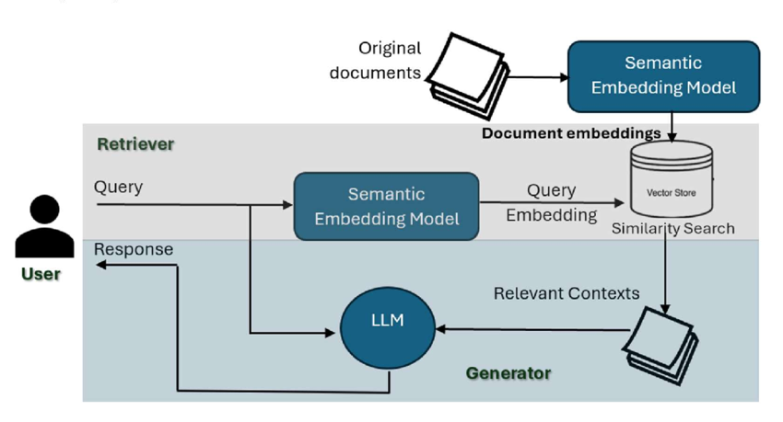
RAG System Architecture

Slide 9
References
[1] Longo, D. L., Fauci, A. S., Kasper, D. L., Hauser, S. L., Jameson, J. L., & Loscalzo, J. (2012). Harrison's Principles of Internal Medicine (18th ed.). McGraw-Hill Education.
[2] Wilkinson, I., Raine, T., Wiles, K., & Goodhart, G. (2020). Oxford Handbook of Clinical Medicine (10th ed.). Oxford University Press.
[3] Reimers, N., & Gurevych, I. (2019). Sentence-BERT: Sentence Embeddings using Siamese BERT-Networks. arXiv preprint arXiv:1908.10084. Retrieved from: https://www.sbert.net/docs/sentence_transformer/pretrained_models.html
[4] Pinecone Systems Inc. (2024). Pinecone Documentation: Vector Database for Semantic Search and RAG. Retrieved from: https://docs.pinecone.io
[5] National Institutes of Health (NIH). PubMed Central – Biomedical and Life Sciences Journal Literature. Retrieved from: https://www.ncbi.nlm.nih.gov/pmc/

Slide 10
Next Presentation Overview
LLM Selection Choosing a suitable Large Language Model for medical Q&A and recommendation generatio.
Connecting LLM with Pinecone: Using retrieved vector data from Pinecone to ground LLM responses.
Prompt Engineering
Memory Handling: Integrating memory to retain previous context in multi-turn conversations.

Slide 11
Thank You

